Slide 1


Learning the ropes
Understanding Python Generics
David Seddon | Kraken Tech | Europython 2023

Slide 2

Do you use a static type checker?

Slide 3
from typing import Generic

Slide 4


Slide 5


Slide 6
1.
Unexpected danger

Slide 7
You’re already using generics (probably).

Slide 8
list[int]
list[str] list[Animal]
list[int]
list[str] list[Animal]
Type variables

Slide 9
class Animal:
def feed(self) -> None:
print("Yum!")
def feed_the_animals(animals: list[Animal]) -> None:
for animal in animals:
animal.feed()
animals = [Animal(), Animal(), Animal()]
feed_the_animals(animals)
Yum!
Yum!
Yum!
Success: no issues found in 1 source file

Slide 10
def feed_the_animals(animals: list[Animal]) -> None:
for animal in animals:
animal.feeed()
😀
error: "Animal" has no attribute "feeed"; maybe "feed"?

Slide 11
class Cat(Animal):
pass
feed_the_animals([Cat(), Cat(), Cat()])
Yum!
Yum!
Yum!
Argument 1 to "feed_the_animals" has incompatible type "List[Cat]"; expected "List[Animal]"

Slide 12
2.
The Liskov Substitution Principle

Slide 13
An object may be replaced with a sub-object without breaking the program.
The Liskov Substitution Principle, paraphrased

Slide 14
An Animal may be replaced with a Cat without breaking the program.

Slide 15
So why is this a useful principle?

Slide 16
Polymorphism.
(Interacting with different types using the same interface.)

Slide 17
for animal in (Cat(), Dog()):
animal.feed()
for animal in (Cat(), Dog()):
if isinstance(animal, Cat):
feed_cat(animal)
elif isinstance(animal, Dog):
feed_dog(animal)

Slide 18
Why won’t mypy let us interact with a list[Cat] as if it is a list[Animal]?
Argument 1 to "feed" has incompatible type "List[Cat]"; expected "List[Animal]"

Slide 19
3.
We need to talk about variance

Slide 20
Variance
or
or
Covariant
Contravariant
Invariant
list[Animal]
list[Animal]
list[Animal]
list[Cat]
list[Cat]
list[Cat]

Slide 21
Variance is a design decision for a typing system

Slide 22
Mypy’s design decision is to adhere to the Liskov Substitution Principle

Slide 23
What should be the variance of list?
Covariant
Contravariant
Invariant

Slide 24
Could list be contravariant?
list[Animal]
def feed_the_animals(animals: list[Animal]) -> None:
for animal in animals:
animal.feed()
objects = [object(), object(), object()]
feed_the_animals(objects)
list[object]
AttributeError: 'object' object has no attribute 'feed'
error: Argument 1 to "feed_the_animals" has incompatible type "List[object]"; expected "List[Animal]"

Slide 25
Could list be covariant?
error: Argument 1 to "feed_the_animals" has incompatible type "List[Cat]"; expected "List[Animal]"

Slide 26
There is now a Dog in a list[Cat]!
class Dog(Animal):
pass
def increase(animals: list[Animal]) -> None:
animals.append(Dog())
cats = [Cat(), Cat(), Cat()]
increase(cats)

Slide 27
animals: list[Animal] = [Cat(), Cat(), Cat()]
increase(animals)
Success: no issues found in 1 source file

Slide 28
Lists are invariant.
This is because they’re mutable collections.
list[Animal]
list[Cat]

Slide 29
tuple

Slide 30
Tuples and other immutable collections are covariant.
Could tuple be covariant?
tuple[Animal, …]
def feed_the_animals(animals: tuple[Animal, ...]) -> None:
for animal in animals:
animal.feed()
cats = (Cat(), Cat(), Cat())
feed_the_animals(cats)
tuple[Cat, …]
Success: no issues found in 1 source file

Slide 31
Variance of return types

Slide 32
covariant (allowing this)...
contravariant (allowing this)...
… or invariant (allowing neither)?
class AnimalFinder:
def find(self) -> Animal:
...
class CatFinder(AnimalFinder):
def find(self) -> Cat:
...
class ObjectFinder(AnimalFinder):
def find(self) -> object:
...

Slide 33
Return types are covariant, too.
class CatFinder(AnimalFinder):
def find(self) -> Cat:
...
class ObjectFinder(AnimalFinder):
def find(self) -> object:
...
✅
⚠️
finder: AnimalFinder = CatFinder()
animal: Animal = finder.find()
finder: AnimalFinder = ObjectFinder()
animal: Animal = finder.find()

Slide 34
Variance of argument types

Slide 35
covariant (allowing this)...
contravariant (allowing this)...
… or invariant (allowing neither)?
class Animal:
def feed(self, food: Food) -> None:
...
class Cat(Animal):
def feed(self, food: CatFood) -> None:
...
class Cat(Animal):
def feed(self, food: object) -> None:
...

Slide 36
Argument types are contravariant.
class Cat(Animal):
def feed(self, food: CatFood) -> None:
...
class Cat(Animal):
def feed(self, food: object) -> None:
...
⚠️
✅
animal: Animal = Cat() animal.feed(Food())

Slide 37
4.
Custom generics

Slide 38
class Cat(Animal):
def feed(self, food: CatFood) -> None:
...
⚠️

Slide 39
What if we don’t
want certain types
to be substitutable?
What if we don’t want a
Cat to be an Animal?

Slide 40
list[object]
list
list[int]
list[str]

Slide 41
Animal
Animal
Cat
Dog
bound to
bound to
Food
Cat Food

Slide 42
from typing import TypeVar
T = TypeVar("T", bound=Food)
from typing import Generic
class Animal(Generic[T]):
... def feed(self, food: T) -> None:
...

Slide 43
animal = Animal() animal.feed(Food())
error: Need type annotation for "animal"
animal = Animal[CatFood]()
animal.feed(Food())
error: Argument 1 to "feed" of "Animal" has incompatible type "Food"; expected "CatFood"
😀
animal = Animal[CatFood]()
animal.feed(CatFood())
Success: no issues found in 1 source file

Slide 44
Animal
class Cat(Animal[CatFood]):
...
Cat
Dog
class Dog(Animal[Food]):
...
bound to
bound to
Food
Cat Food

Slide 45
class Cat(Animal[CatFood]):
...
def feed(self, food: CatFood) -> bool:
...
class Animal(Generic[T]):
...
def feed(self, food: T) -> None:
...

Slide 46
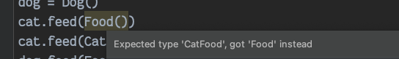

Slide 47
A
B
C

Slide 48
5.
Case study

Slide 49
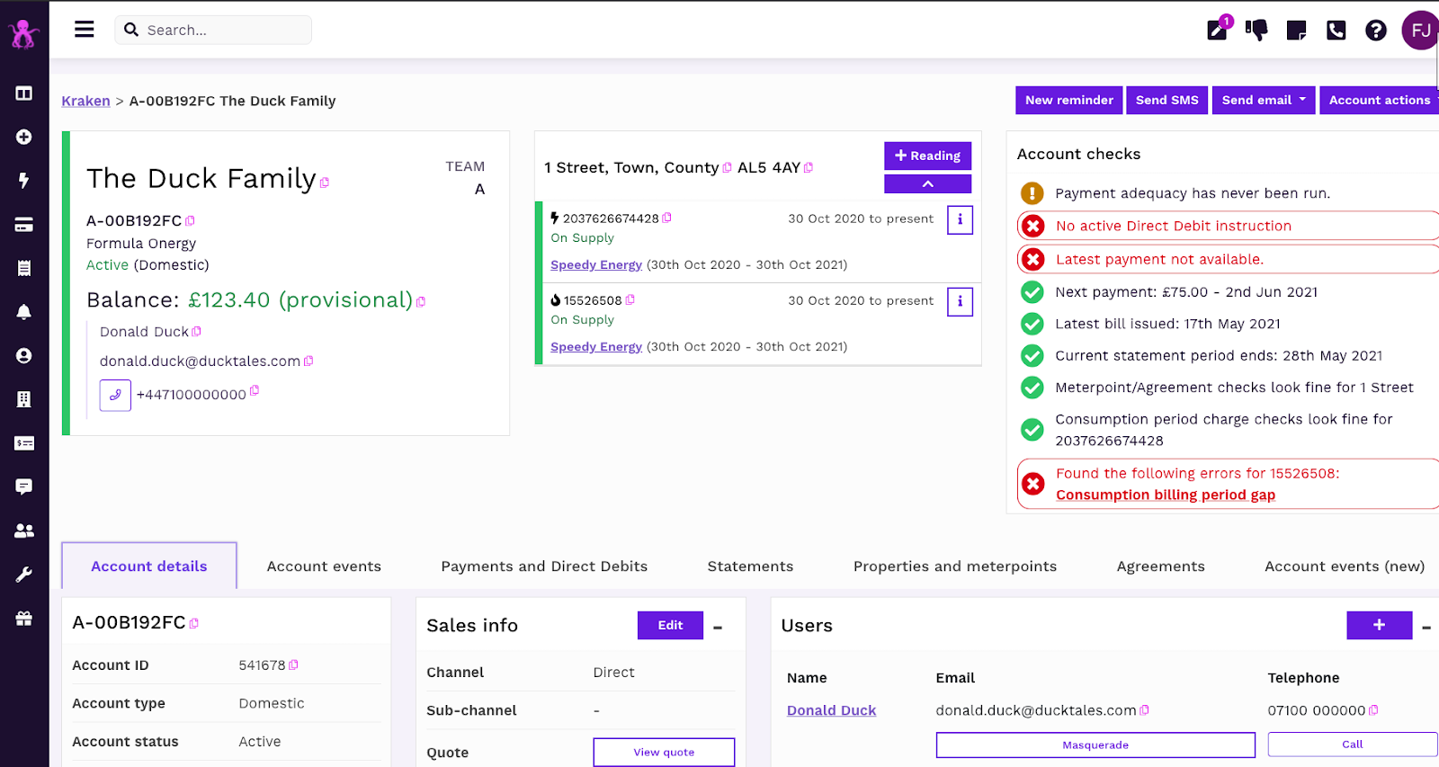


‘Kraken’

Slide 50

Customer registration in Kraken
🇬🇧
🇮🇹
🇯🇵
Customer
Customer
Customer
def register(**kwargs: Any) -> Account:
...
🙁

Slide 51
Engines and contexts
Registration Engine save_custom_context(account, context)
Registration Context
UK Engine
Italy Engine
Japan Engine
UK Context
Italy Context
Japan Context

Slide 52
register(
engine=ItalyEngine(),
context=ItalyContext(
name="Marco Bianchi",
email="marcob@gmail.com",
address=Address(
line1="Via delle Viole 11",
line2="Povegliano Veronese",
line3="Salerno",
postal_code="14026",
),
phone_number="0397 8142253",
opted_in_to_marketing=True,
fiscal_code="MRTMTT91D08F205J",
),
)

Slide 53
def register(engine: RegistrationEngine, context: RegistrationContext) -> Account:
account = _create_account(context)
engine.save_custom_context(account, context)
return account
class RegistrationEngine:
def save_custom_context(
self, account: Account, context: RegistrationContext
) -> None:
pass

Slide 54
@dataclass
class RegistrationContext:
name: str
email: str
address: Address
phone_number: str
opted_in_to_marketing: bool

Slide 55
Can anyone spot the problem with this design?
Argument types are contravariant!
@dataclass
class ItalyContext(RegistrationContext):
fiscal_code: str
class ItalyEngine(RegistrationEngine):
def save_custom_context(self, account: Account, context: ItalyContext) -> None:
save_italy_data(account=account, fiscal_code=context.fiscal_code)
error: Argument 2 of "save_custom_context" is incompatible with supertype "RegistrationEngine"; supertype defines the argument type as "RegistrationContext"
note: This violates the Liskov substitution principle

Slide 56
So what’s the answer?

Slide 57
Registration Engine save_custom_context(account, context)
Registration Engine save_custom_context(account, context)
Registration Context
TypeVar
UK Engine
Italy Engine
Japan Engine
UK Context
Italy Context
Japan Context

Slide 58
from typing import Generic, TypeVar
T = TypeVar("T", bound=RegistrationContext)
class RegistrationEngine(Generic[T]):
def save_custom_context(self, account: Account, context: T) -> None:
pass
class ItalyEngine(RegistrationEngine[ItalyContext]):
def save_custom_context(self, account: Account, context: ItalyContext) -> None:
...
def register(engine: RegistrationEngine[T], context: T) -> Account:
...
😀 😀 😀
Success: no issues found in 1 source file

Slide 60
Thank you!
seddonym.me import-linter.readthedocs.io
We’re hiring: octopus.energy/kraken-tech-careers

Slide 61
Appendix

Slide 62
dict[str, Animal]
type of the keys
type of the values

Slide 63
Summary of variance (as Mypy sees it)
Mutable collections (list, set) | Invariant
Immutable collections (tuple, frozenset, Sequence) | Covariant
Return types | Covariant
Argument types | Contravariant

Slide 64
def feed_the_animals(animals: list[Animal]) -> None:
for animal in animals:
animal.feeed()
😀
error: "Animal" has no attribute "feeed"; maybe "feed"?
feed_the_animals([Animal(), 33, Animal()])
😀
error: List item 1 has incompatible type "int"; expected "Animal"

